Slide 1

2021
1

Slide 2

Biography
Degree in Accounting and Finance
Experience - data analyst and research analyst

Slide 3
Prediction of Bitcoin price using social media
Capstone Project
Jin Yang

Slide 4
AGENDA
BIO
PROJECT CONTEXT
DEFINE
DESIGN
DELIVER
SUMMARY, CONCLUSION AND NEXT STEPS

Slide 5
PROJECT CONTEXT
The cryptocurrency market has grown significantly over the years.
”Bitcoin has been increasingly regarded as an investment asset” (Chen et al., 2020)
From $127.5 Billion in January 2019 to $1.75 Trillion in May 2021 (in USD) which has increased 13 times over 2 years (CoinMarketCap, 2021).
For U.S Equity Market Value (in USD), from $30 Trillion in 31/12/2018 to $49 Trillion in 31/3/2021. This is 1.6 times over 2 years (Siblis, 2021).

Slide 6
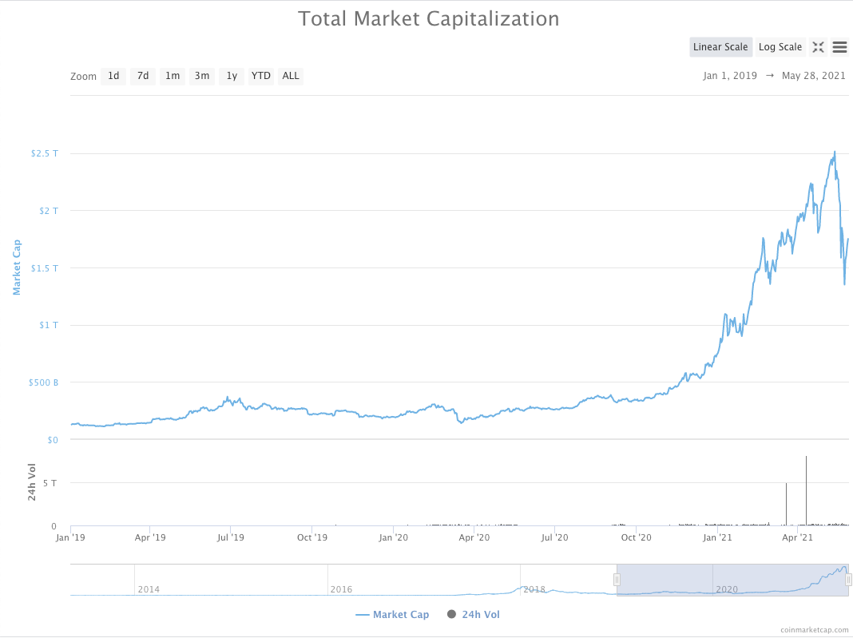
PROJECT CONTEXT

Slide 7
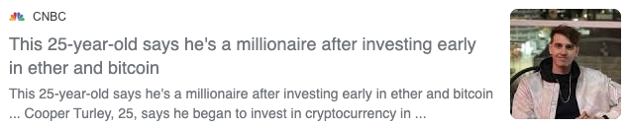
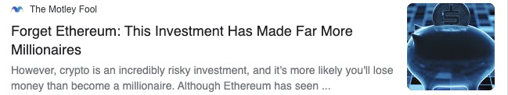
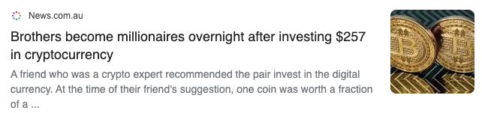
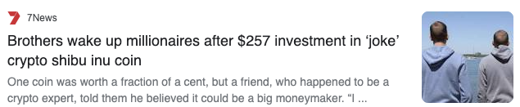

Slide 8
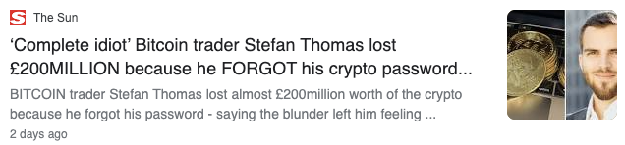
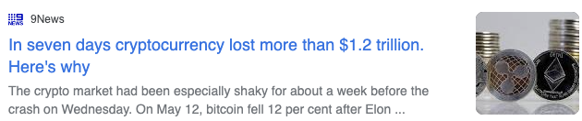
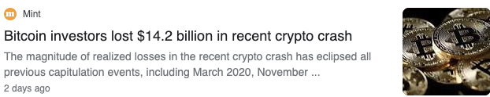
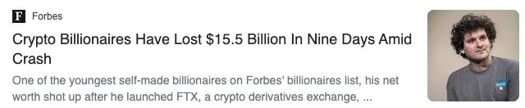
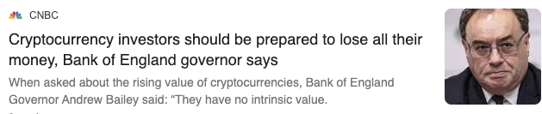

Slide 9
PROJECT CONTEXT
Cryptocurrency market is a great setting to investigate the market sentiment as there is no fundamental value to the currency.
Bitcoin is a digital currency where no government or central bank backing have much affect on the value of bitcoin, including a nation’s monetary policies, macroeconomic conditions, and inflation and interest rates (Mai, et al., 2018)
Prior studies finds that social media affects the bitcoin’s value (Mai et al., 2018).
Bitcoin is highly speculative investment (SEC, 2021).

Slide 10
BUSINESS QUESTION AND DATA QUESTION
Business Question:
Can we predict cryptocurrency price (Bitcoin) and improve investment risk management using social media?
Data Question:
Can we develop a model to predict Bitcoin price? Which of the information from different social media is better at explaining the variation in Bitcoin price?
The focus of this analysis is on bitcoin (BTC-USD)

Slide 11
AGENDA
BIO
PROJECT CONTEXT
DEFINE
DESIGN
DELIVER
SUMMARY, CONCLUSION AND NEXT STEPS

Slide 12
DATA SOURCE
Periods from Jan 2020 to May 2021
Data sourced from 4 different data base
Twitter API (tweepy)
Obtain tweets from selected users who are highly influential in bitcoin.
Google Trends (pytrends)
Wikipedia page views (pageviewapi)
Bitcoin price (CoinBase API (Historic_Crypto))

Slide 13
Twitter Sentiment Analysis
Text Processing
  Obtained 12,925 tweets from 8 users
  'APompliano', 'DocumentingBTC', 'scottmelker', 'brian_armstrong', 'cameron', 'tyler', 'michael_saylor', 'Bitcoin’
Remove URLs, retweets, hashtags & punctuations
Remove emojis & emoticons
Remove stop words
Lemmatization
Sentiment analysis
Collapse to daily data for merging

Slide 14
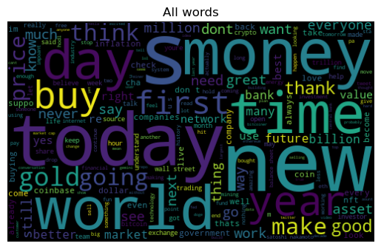
All words

Slide 15
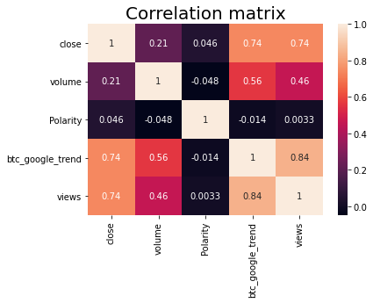

Slide 16
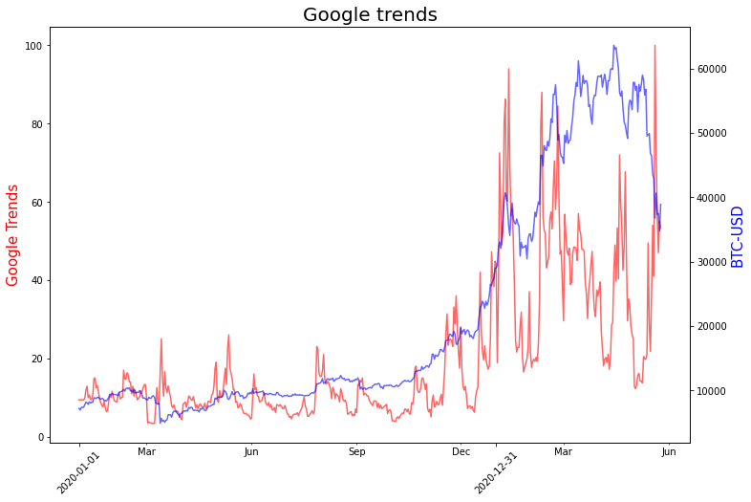

Slide 17
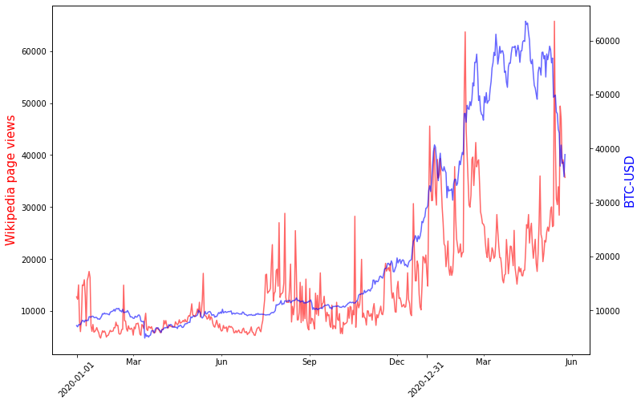

Slide 18
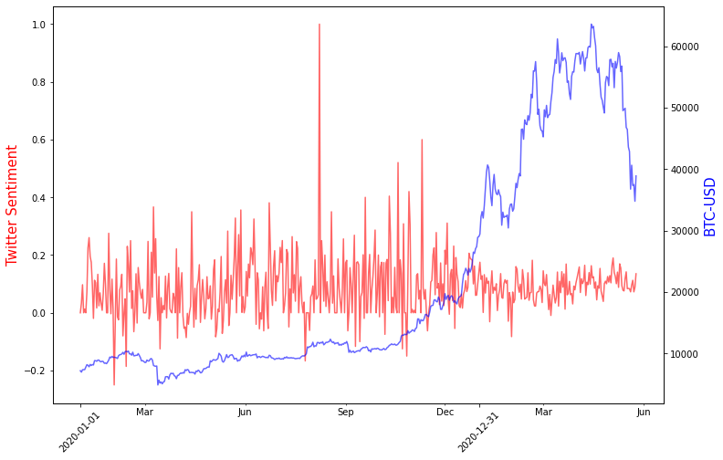

Slide 19
Models
Long short-term memory (LSTM)
  3 days timesteps
Other models
  Random Forest
  Linear regression
  Lasso regression
  Decision Tree Regressor
  Kneighbors Regressor

Slide 20
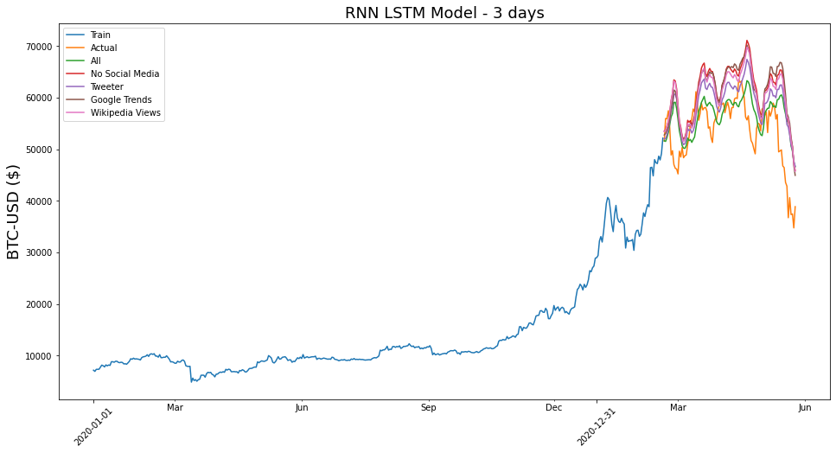

Slide 21
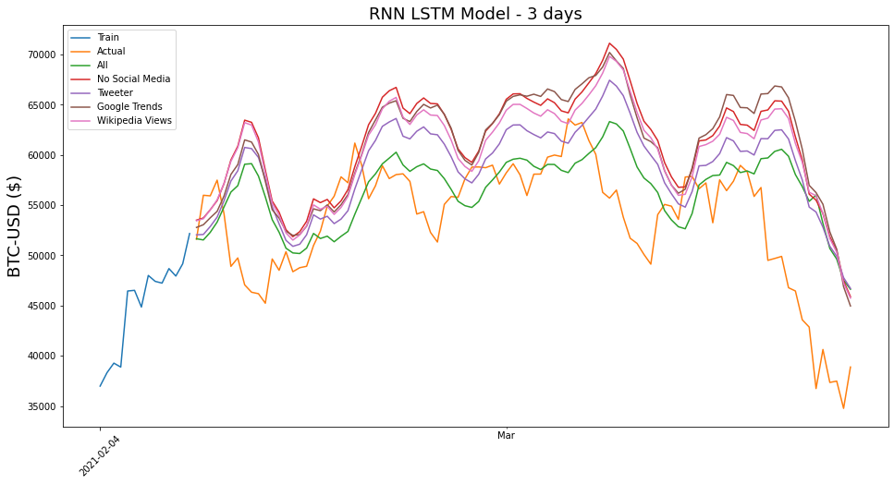

Slide 22
LSTM predictions
LSTM predictions
 |  |  |  | Prediction price (3 outcomes)
 | Loss | Val_loss | Prediction price tomorrow (1 outcome) | t+1 | t+2 | t+3
LSTM - All | 0.004 | 0.0278 | 46,621 | 41,051 | 43,822 | 45,045
LSTM - No social media | 0.0016 | 0.0091 | 45,886 | 43,981 | 47,386 | 49,765
LSTM - Tweeter | 0.0024 | 0.0174 | 46,709 | 44,782 | 47,533 | 49,256
LSTM - Google Trends | 0.0015 | 0.0071 | 44,956 | 42,831 | 45,004 | 47,745
LSTM - Wikipedia | 0.0015 | 0.0079 | 45,739 | 46,246 | 46,522 | 50,272

Slide 23
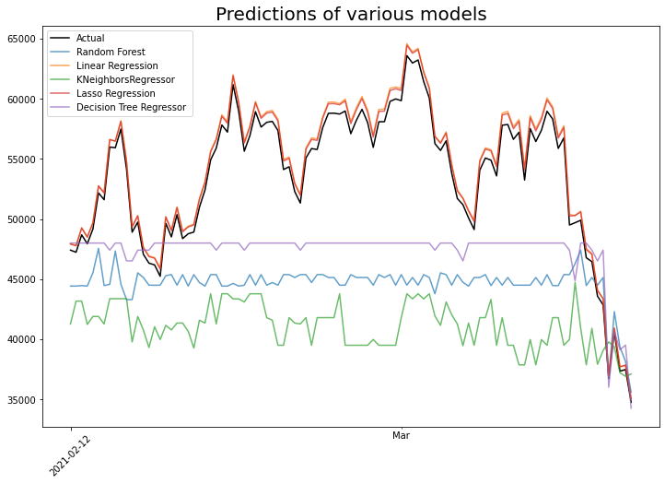

Slide 24
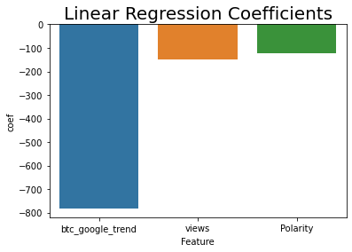

Slide 25
Summary, Conclusions and Next Steps
Summary
Google Trends and Wikipedia page views have high positive correlation with bitcoin price.
Based on LSTM model using 3 days as the timesteps, LSTM with Google Trends has the lowest loss function compared to the other models.
The prediction line including all social media is closest to the validation data when plotted in graph.
Other models such as Linear regression and Lasso regression have high accuracy scores.
Limitation
Sentiment analysis only on selected twitter users.
Analysed on daily data
Short sample periods

Slide 26
Summary, Conclusions and Next Steps
Conclusions
Some evidence that social media information help us to explain the variation in bitcoin price and predict bitcoin price.
Some evidence that social media help to manage risk when investing bitcoin.
Google trends has the highest correlation and explains the variation in the bitcoin price the most.
Next steps
Develop algorithmic trading strategy.
Extend the sample periods and use hourly/minutes data.
Extend other twitter account users and hashtags
Further analysis on other cryptocurrencies and in stock market.

Slide 27
Reference
Chen, Z., Li, C. and Sun, W., 2020. Bitcoin price prediction using machine learning: An approach to sample dimension engineering. Journal of Computational and Applied Mathematics, 365, p.112395.
Coinmarketcap (2021), https://coinmarketcap.com/charts/
Mai, F., Shan, Z., Bai, Q., Wang, X. and Chiang, R.H., 2018. How does social media impact Bitcoin value? A test of the silent majority hypothesis. Journal of management information systems, 35(1), pp.19-52.
SEC, 2021. Staff Statement on Funds Registered Under the Investment Company Act Investing in the Bitcoin Futures Market, US Securities and Exchange Commision, <https://www.sec.gov/news/public-statement/staff-statement-investing-bitcoin-futures-market>
Siblis (2021), https://siblisresearch.com/data/us-stock-market-value/

Slide 28
Appendices

Slide 29
Other models
 | Prediction price tomorrow | Accuracy
Random Forest | 40,413 | 98.627%
Linear Regression | 39,261 | 99.189%
Lasso Regression | 39,267 | 99.192%
DecisionTreeRegressor | 46,448 | 98.548%
KNeighborsRegressor | 37,650 | 97.566%

Slide 30
Polarity means by Twitter users
Twitter accounts | Polarity Mean
Apompliano | 0.125
Bitcoin | 0.078
DocumentingBTC | 0.074
brian_armstrong | 0.162
cameron | 0.112
michael_saylor | 0.090
scottmelker | 0.090
tyler | 0.084
Total | 0.095

Slide 31
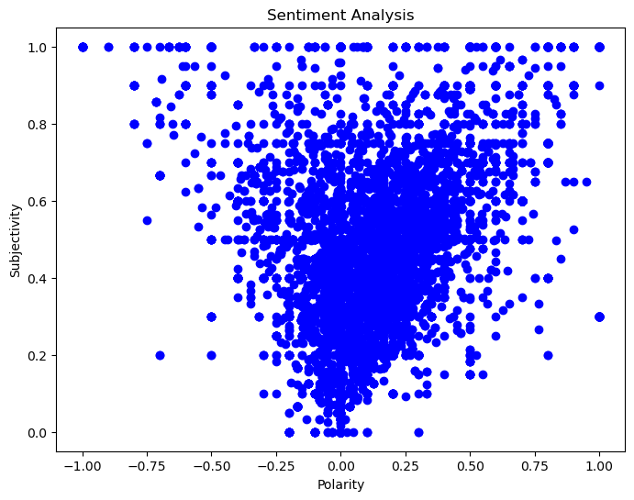

Slide 32
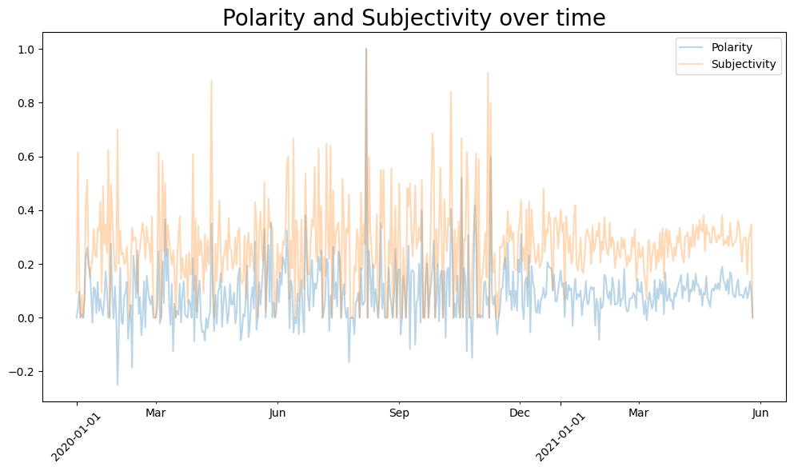

Slide 33
End of Presentation!

